Slide 1
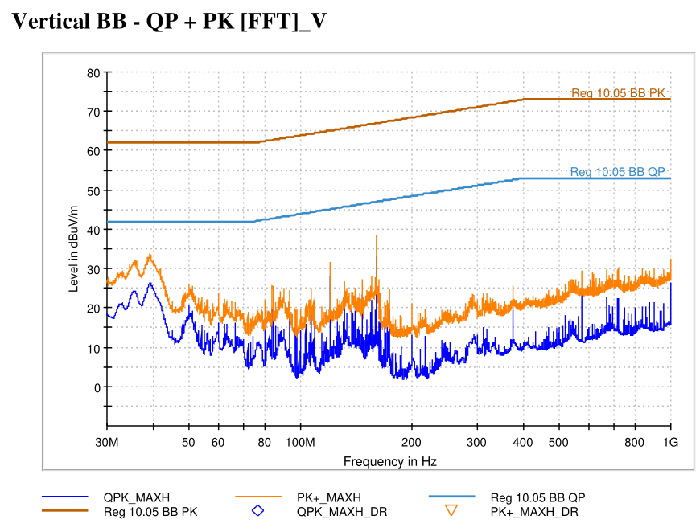
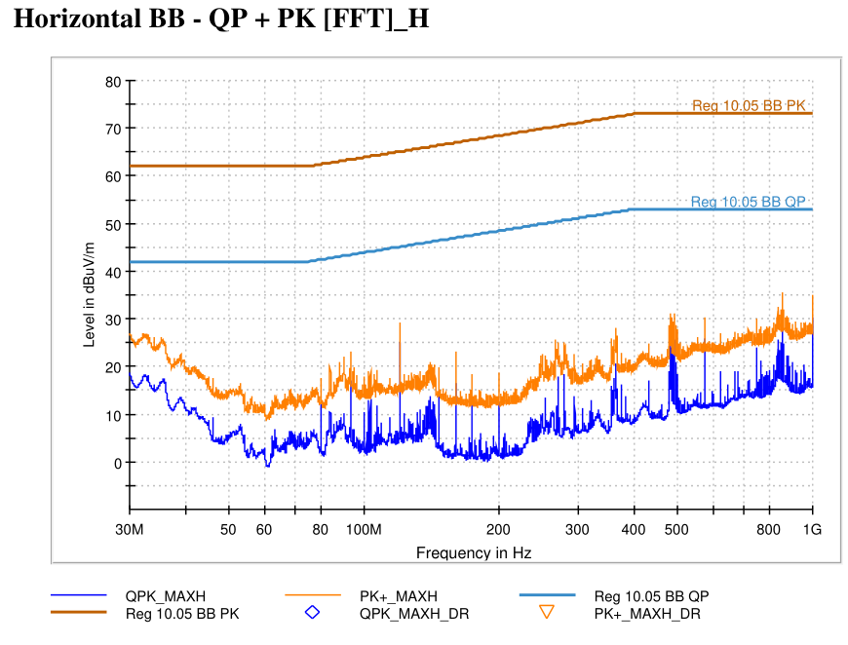
5599 - State 3 RLBB | VT-01 Off-Board Emissions (3m)
State Information

Slide 2
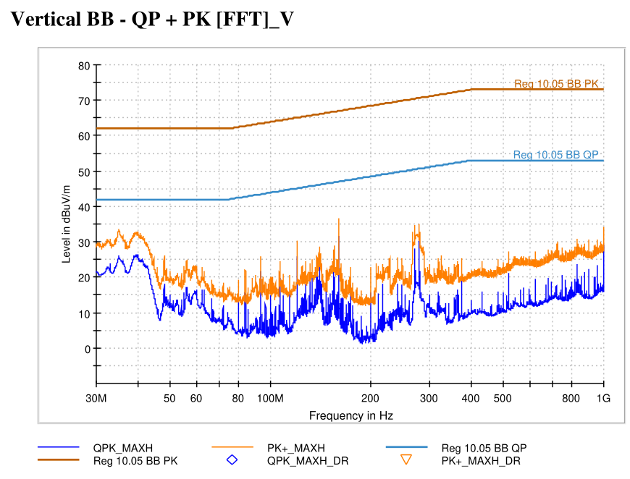
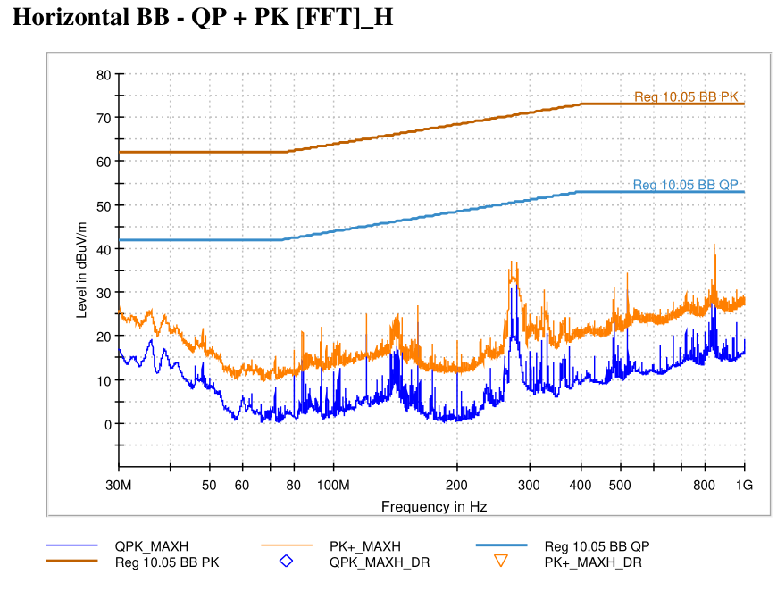
5599 - State 7 RBBB | VT-01 Off-Board Emissions (3m)
State Information

Slide 3
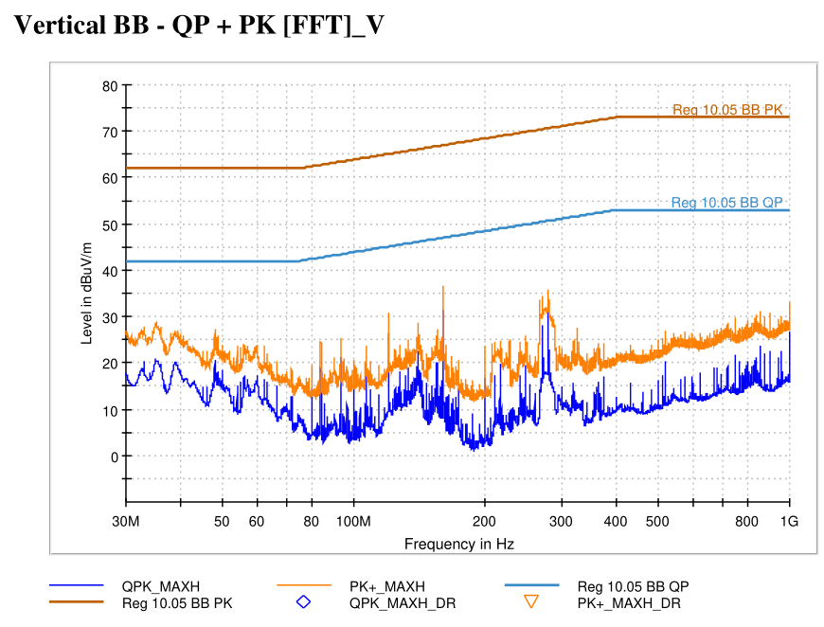
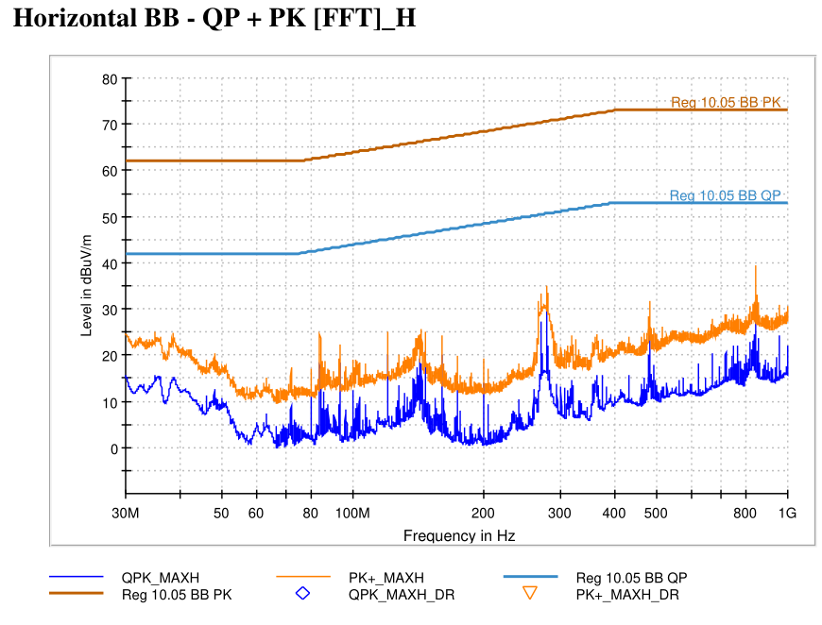
5599 - State 2 RRBB | VT-01 Off-Board Emissions (3m)
State Information

Slide 4
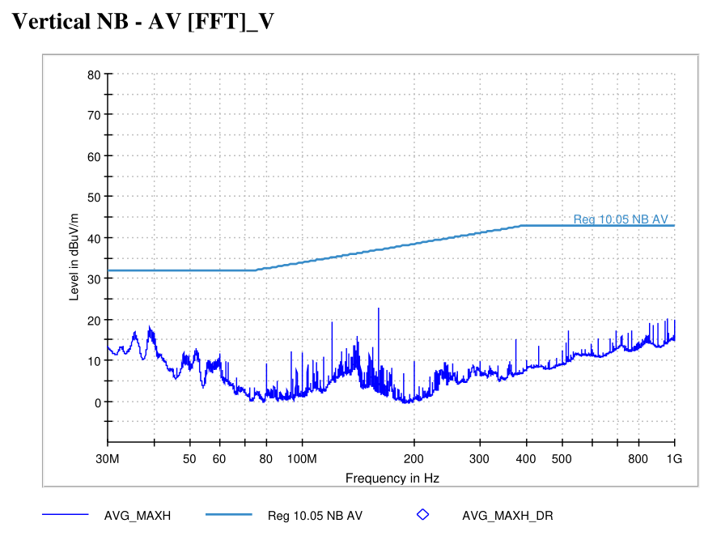
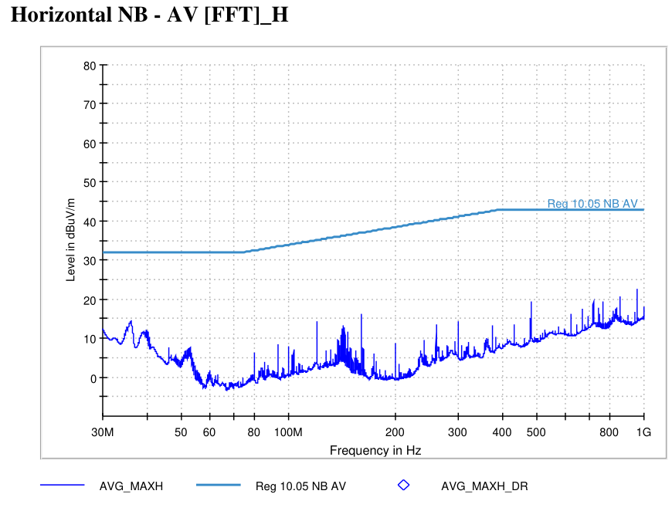
5599 - State 8 RRNB | VT-01 Off-Board Emissions (3m)
State Information

Slide 5
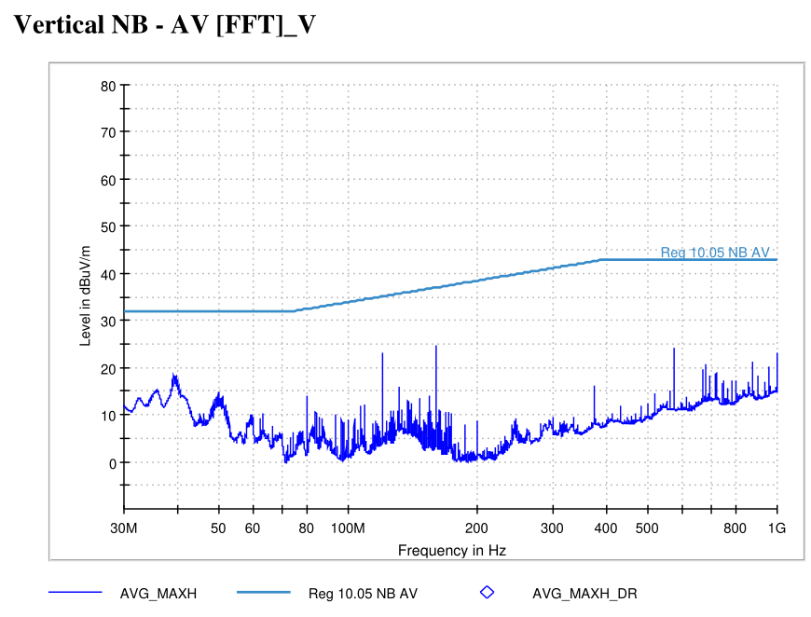
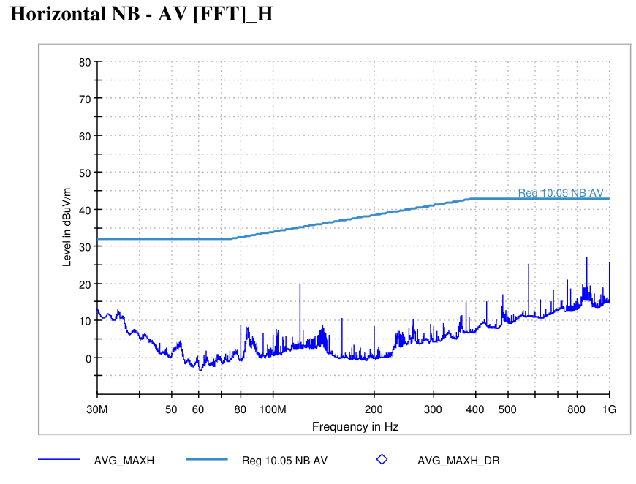
5599 - State 4 RLNB | VT-01 Off-Board Emissions (3m)
State Information

Slide 6
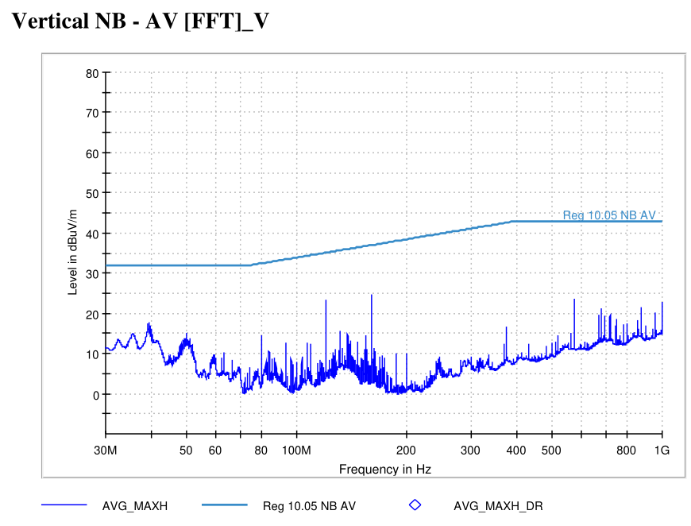
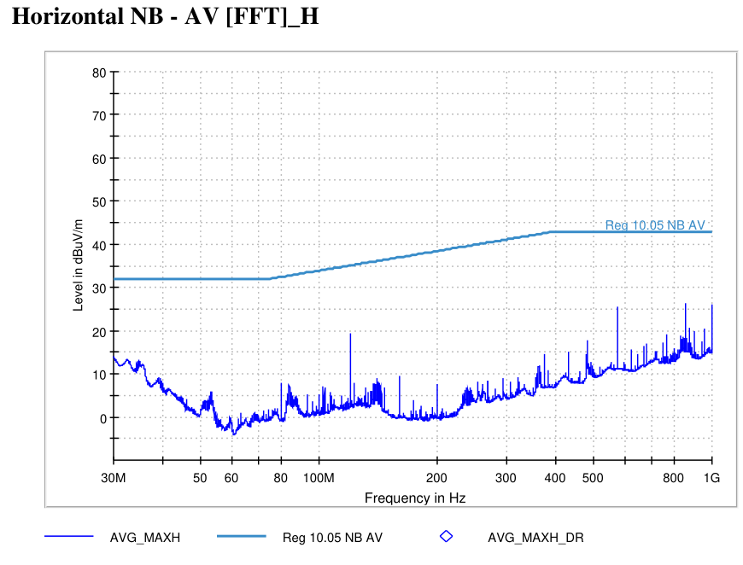
5599 - State 5 RLNB | VT-01 Off-Board Emissions (3m)
State Information

Slide 7
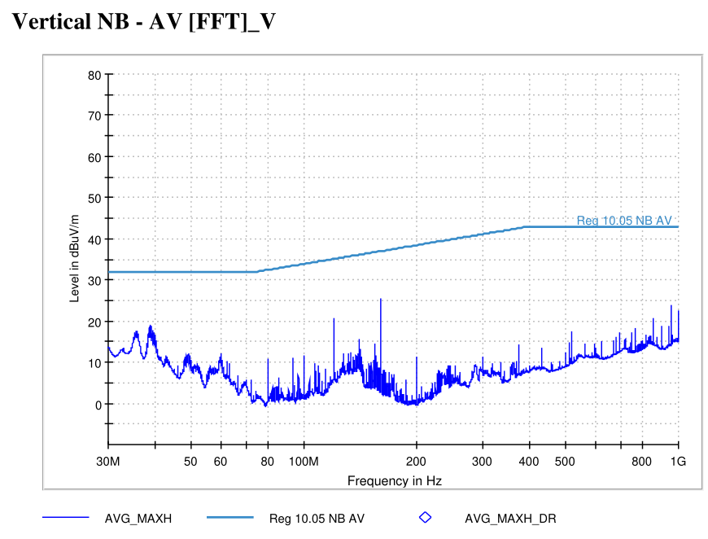
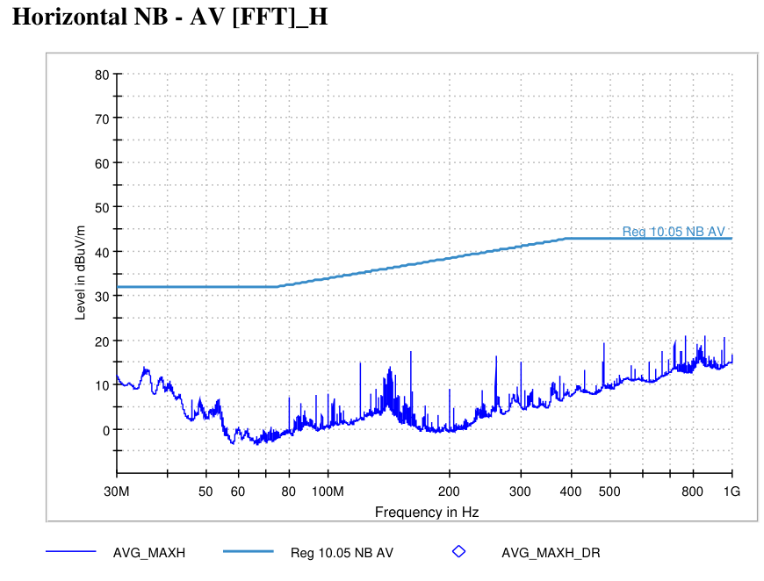
5599 - State 1 RRNB | VT-01 Off-Board Emissions (3m)
State Information

Slide 8
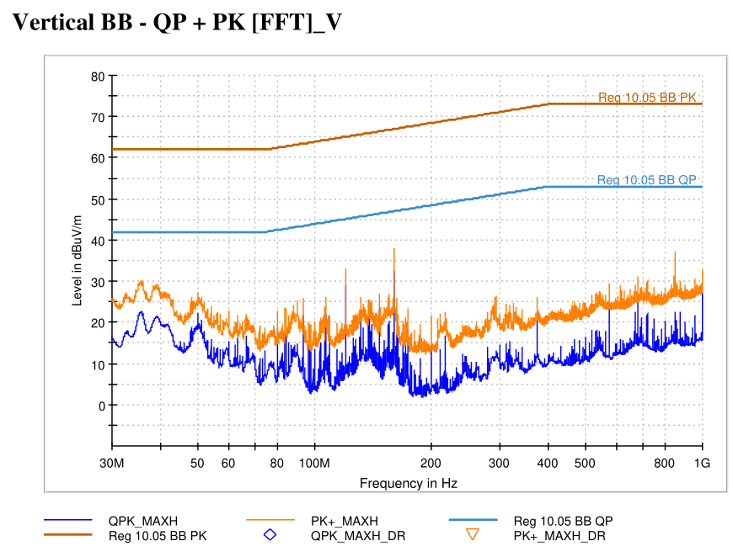
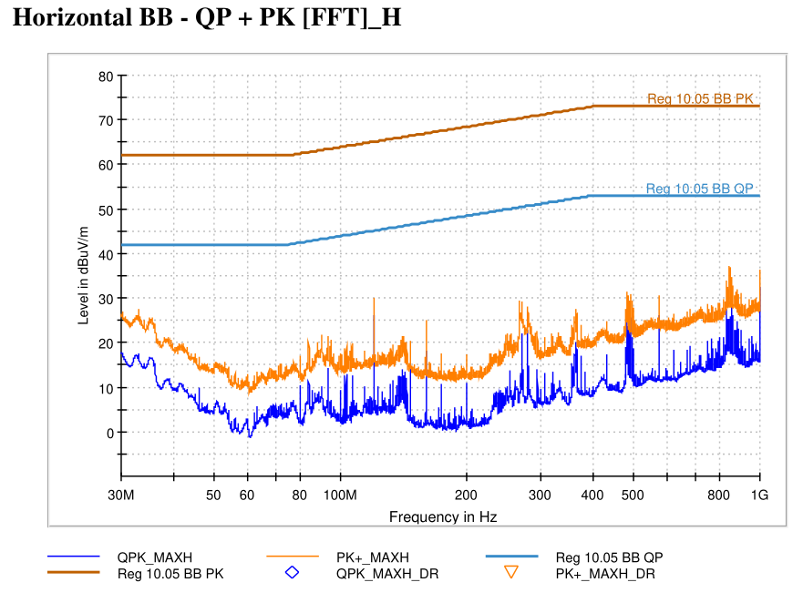
5599 - State 6 RLBB | VT-01 Off-Board Emissions (3m)
State Information

Slide 9
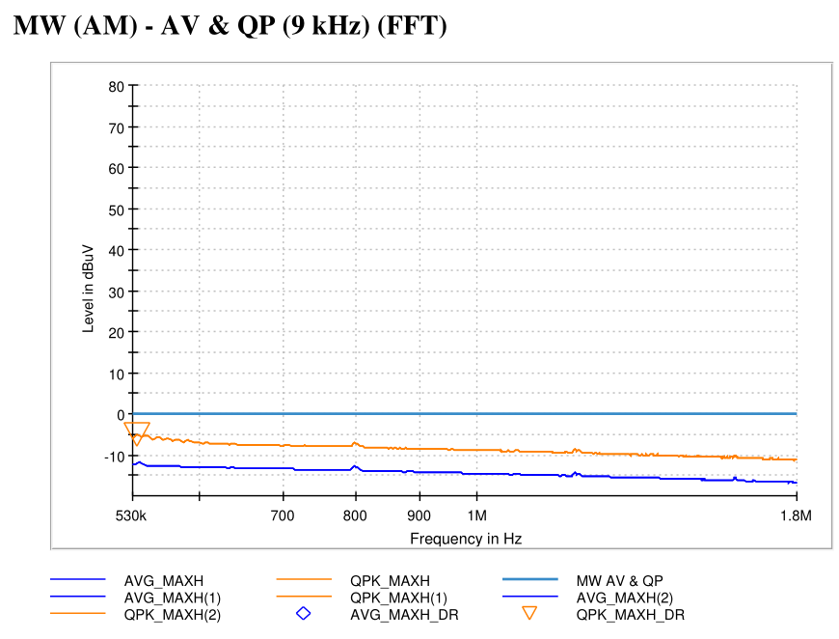
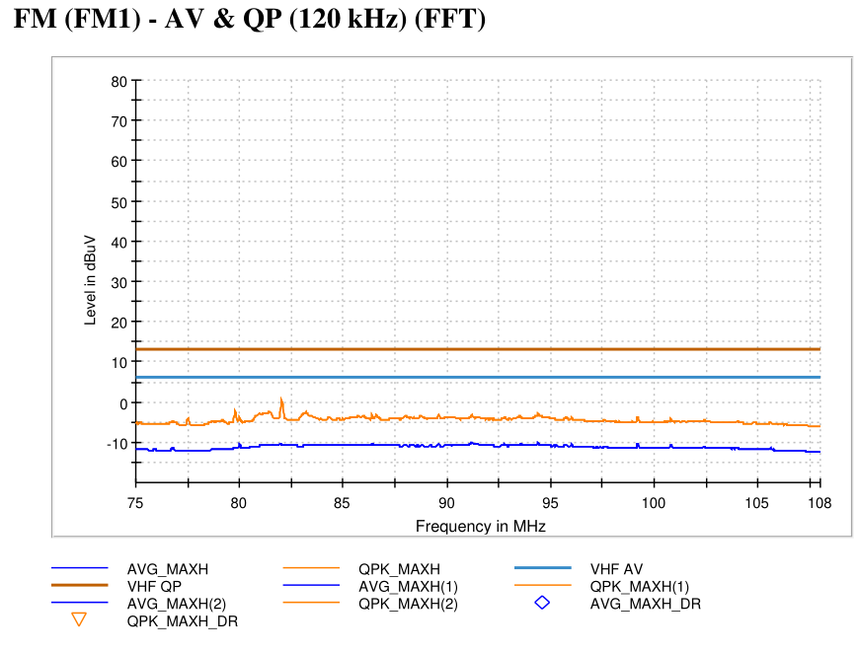
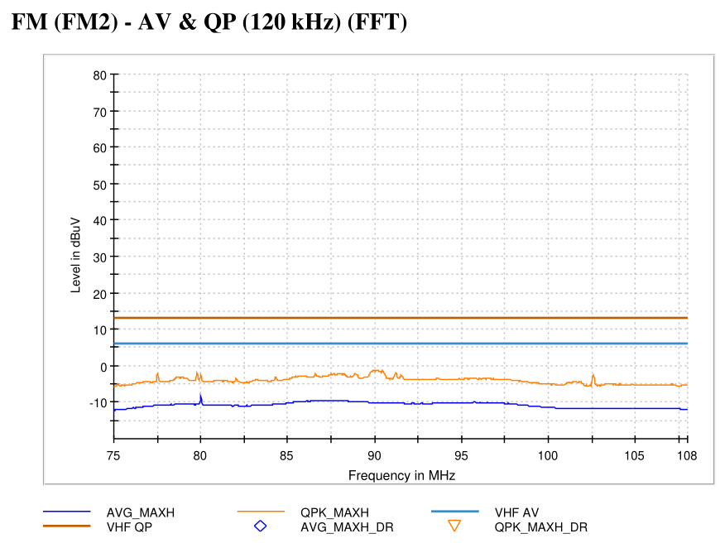
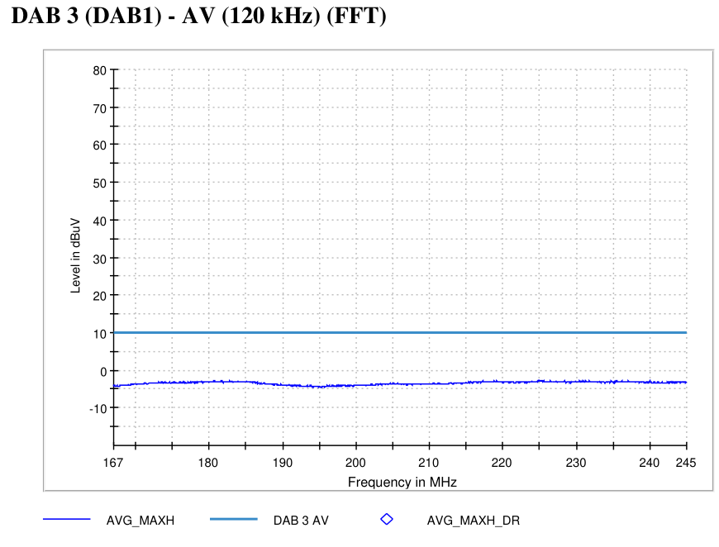
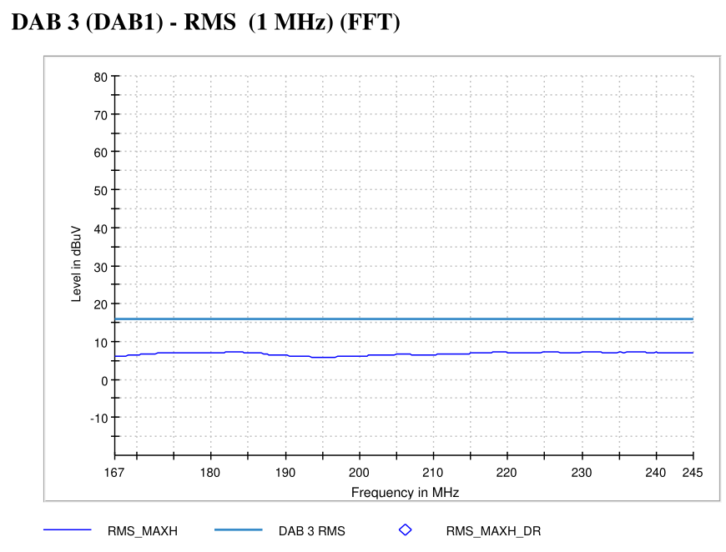

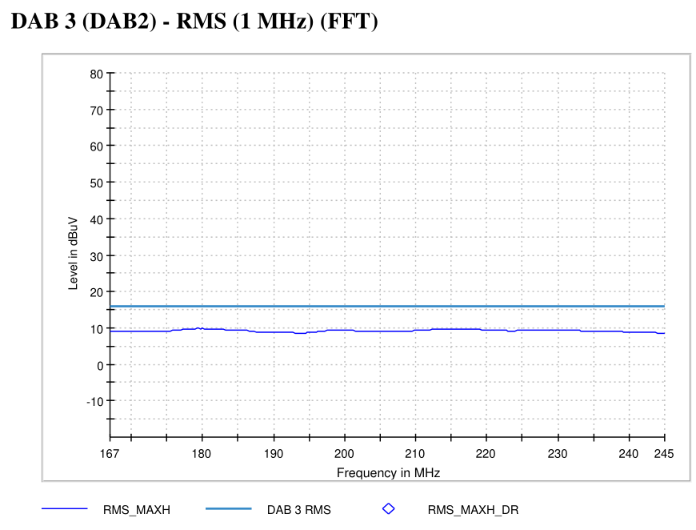
5599 - State 9 | VT-07 On-Board Emissions
State Information

Slide 10
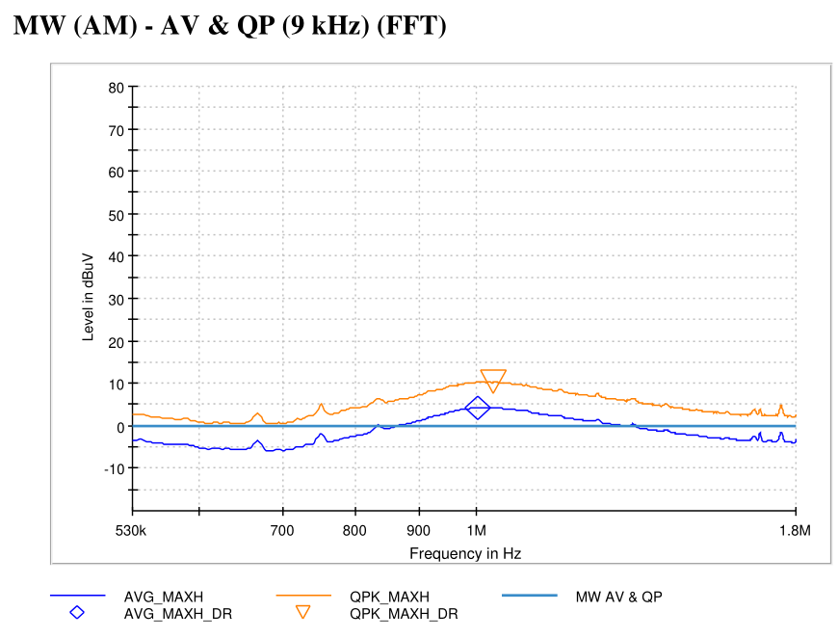
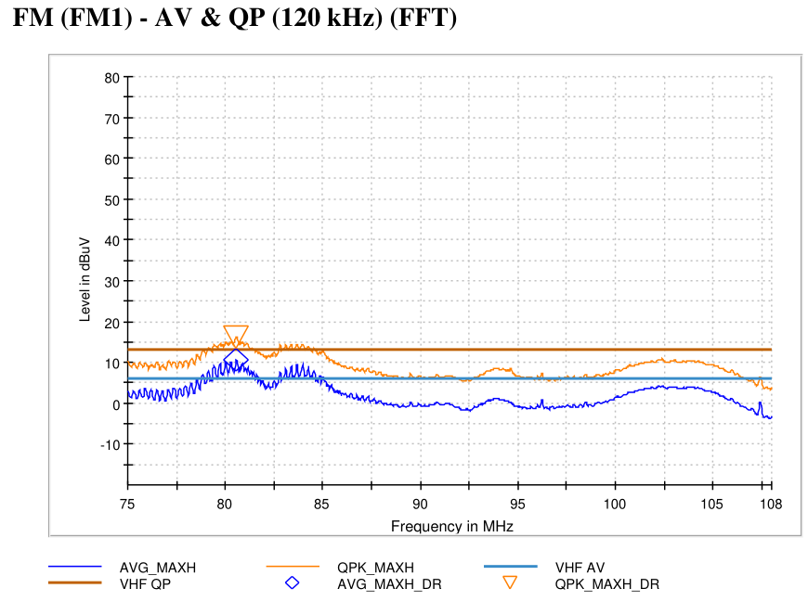
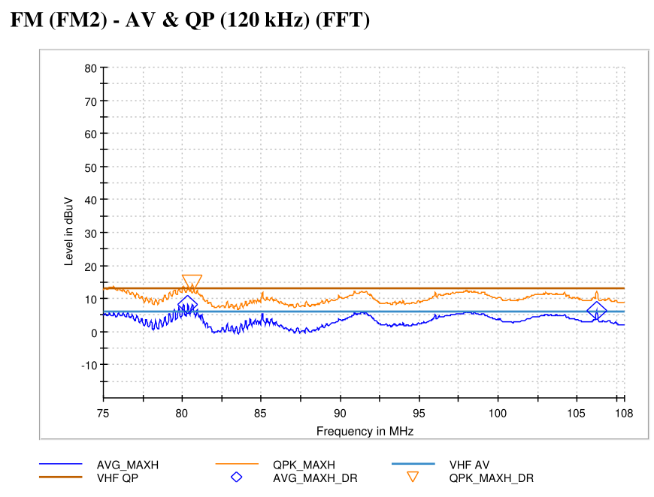
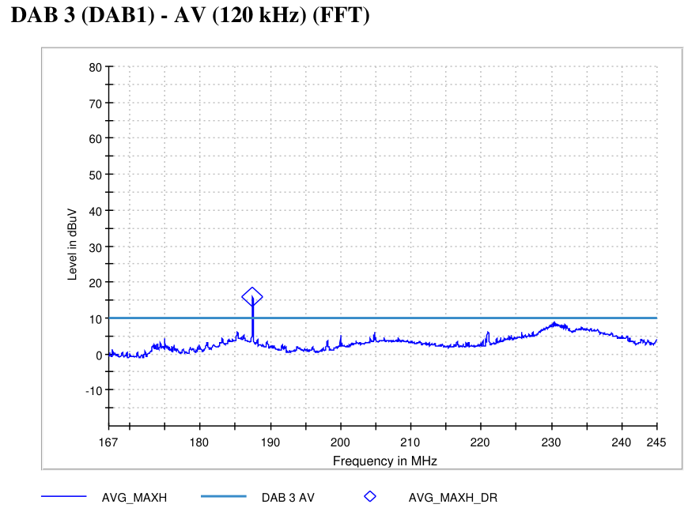
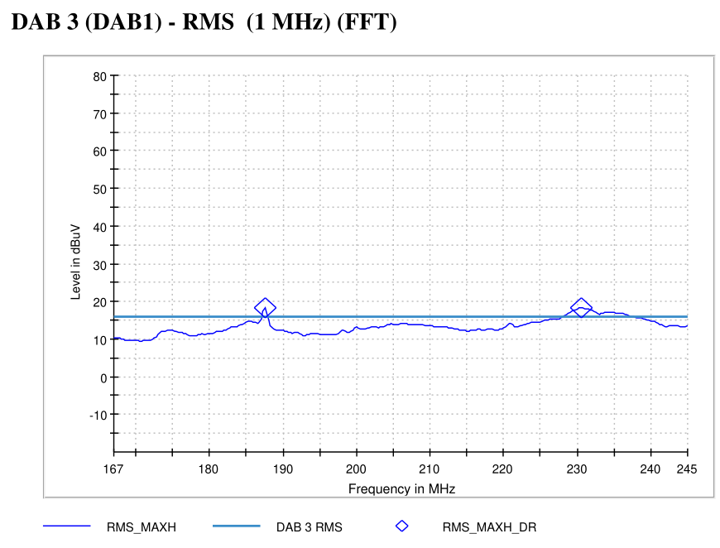
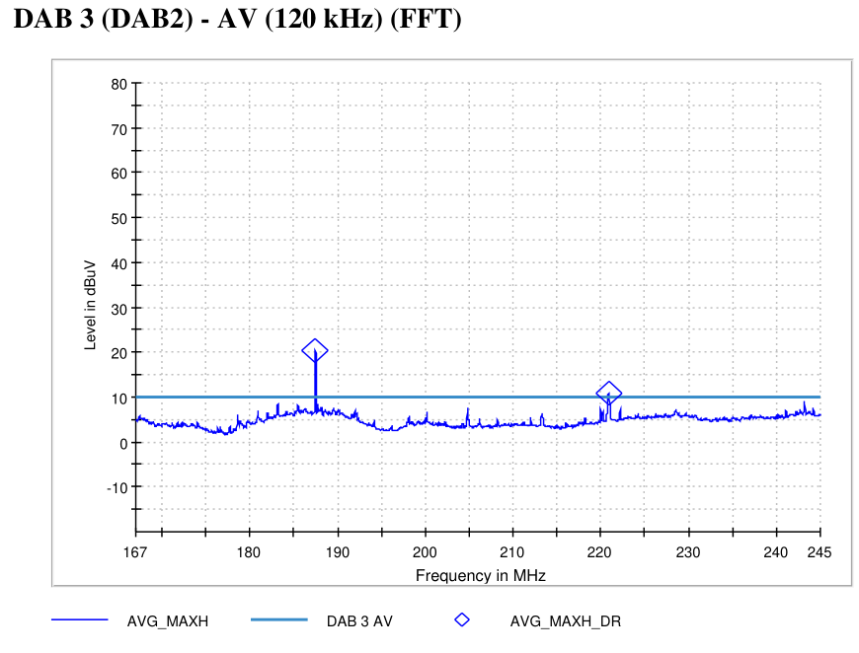
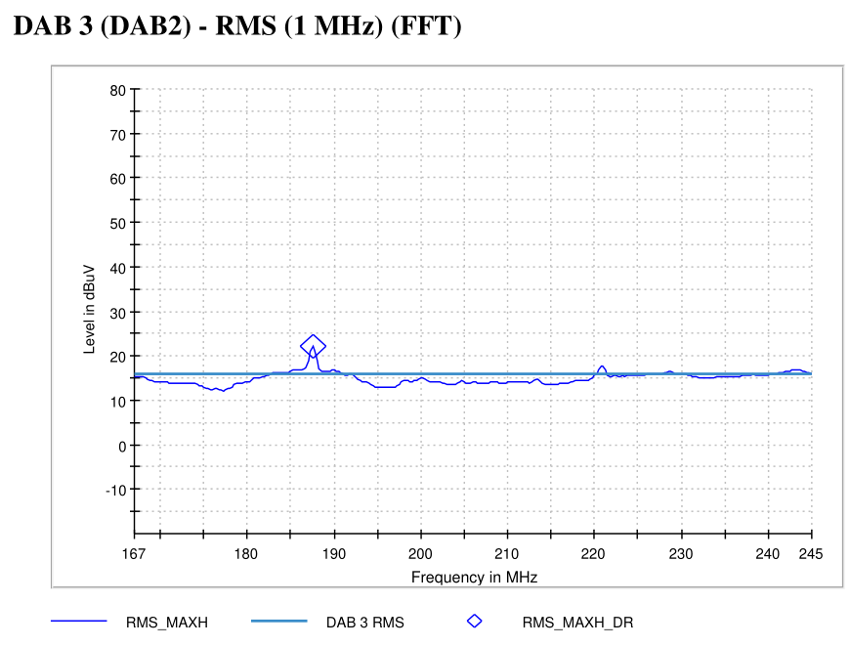
5599 - State 13 | VT-07 On-Board Emissions
State Information

Slide 11
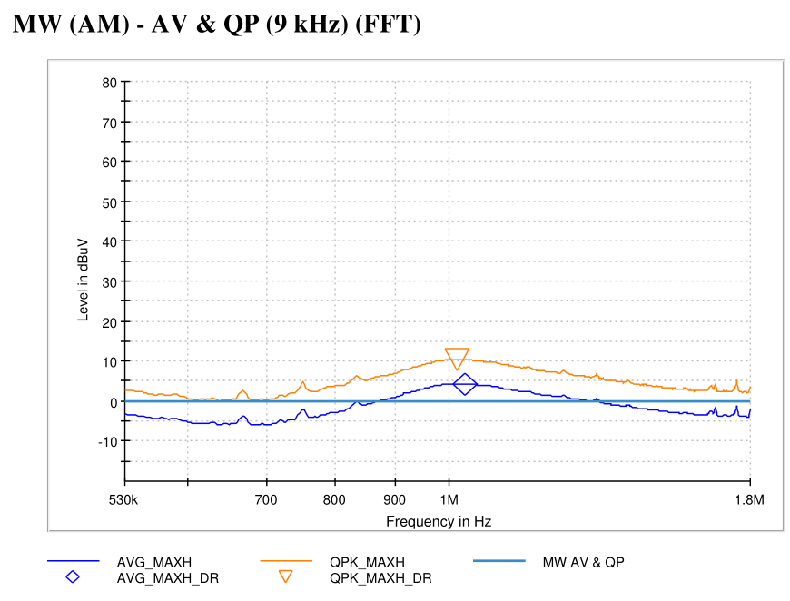
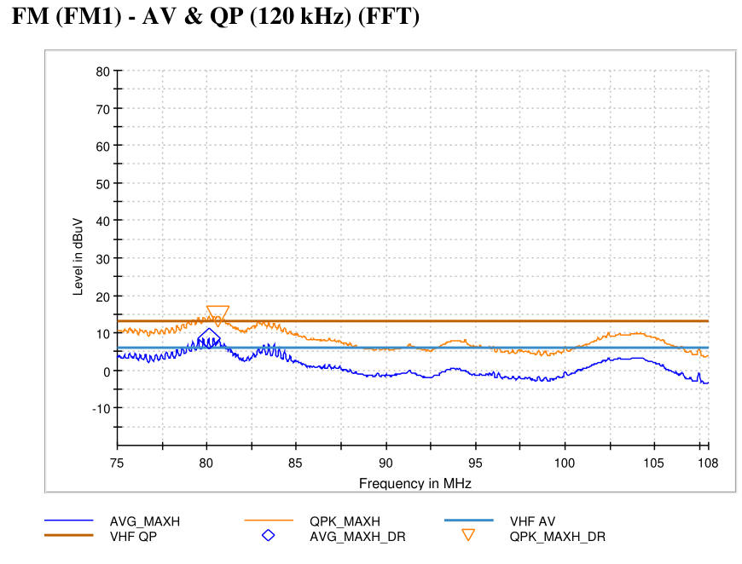
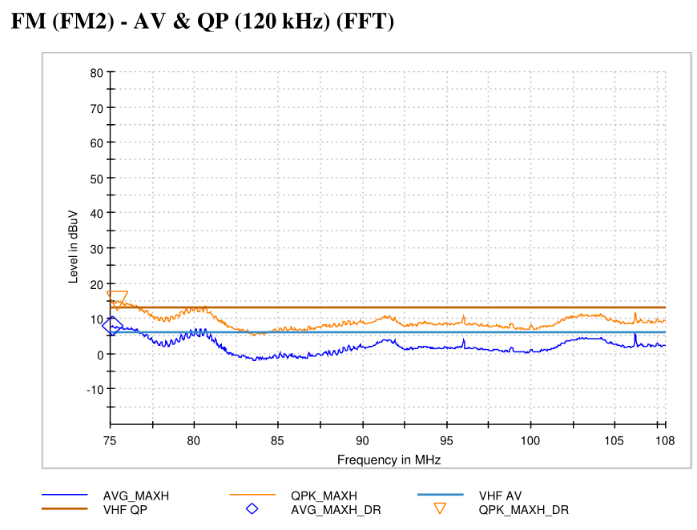
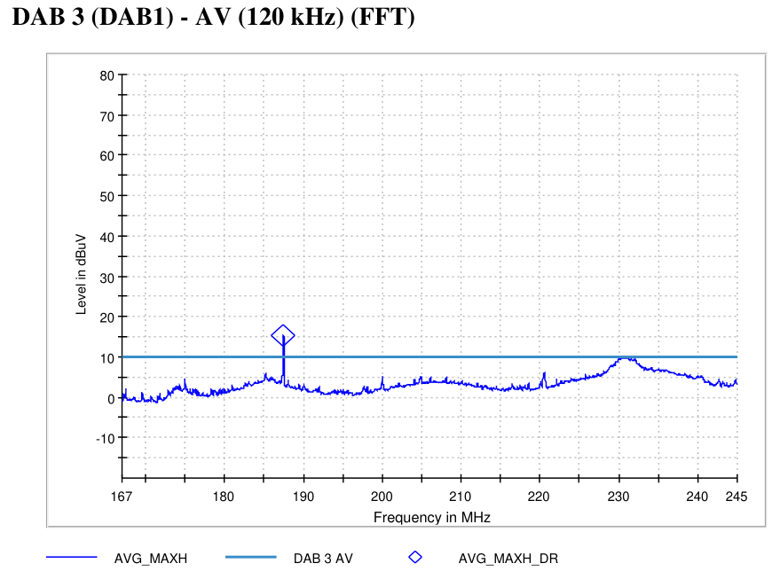

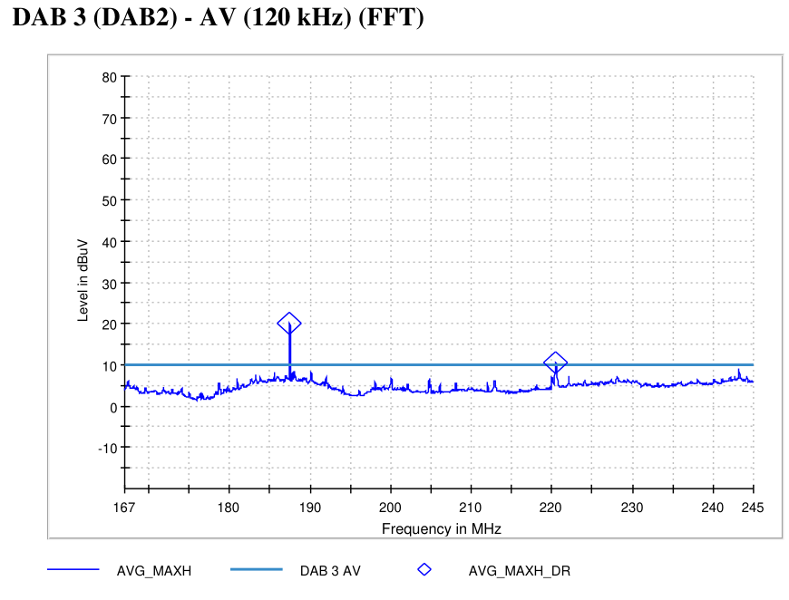
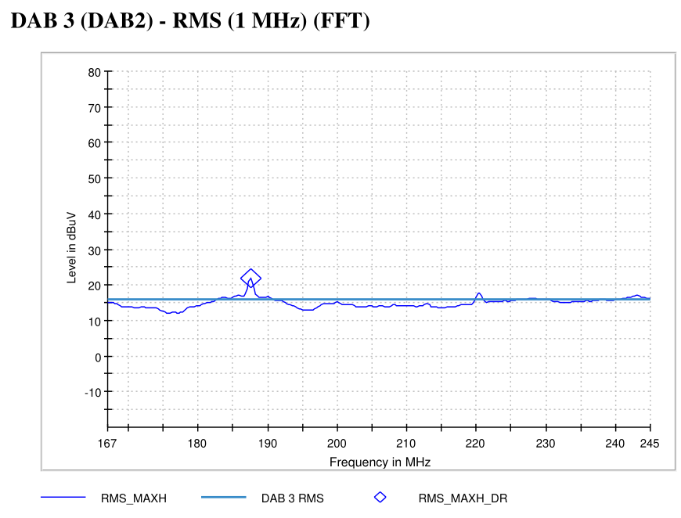
5599 - State 12 | VT-07 On-Board Emissions
State Information

Slide 12
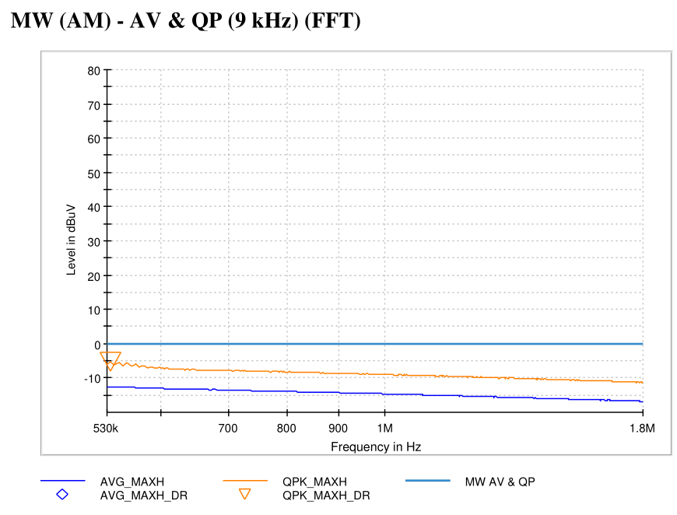
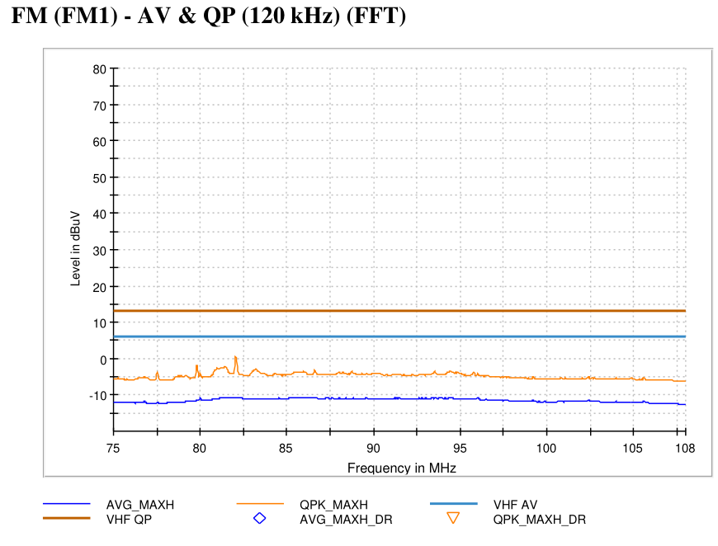


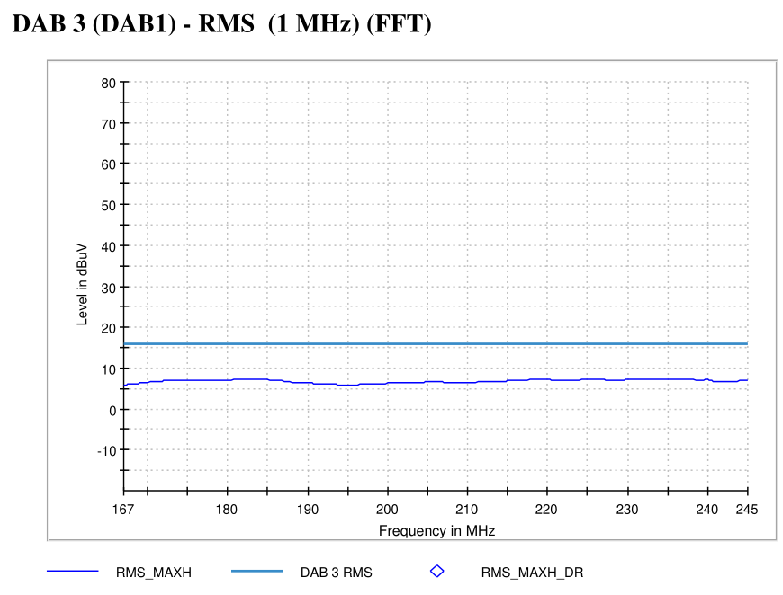


5599 - State 10 | VT-07 On-Board Emissions
State Information

Slide 13
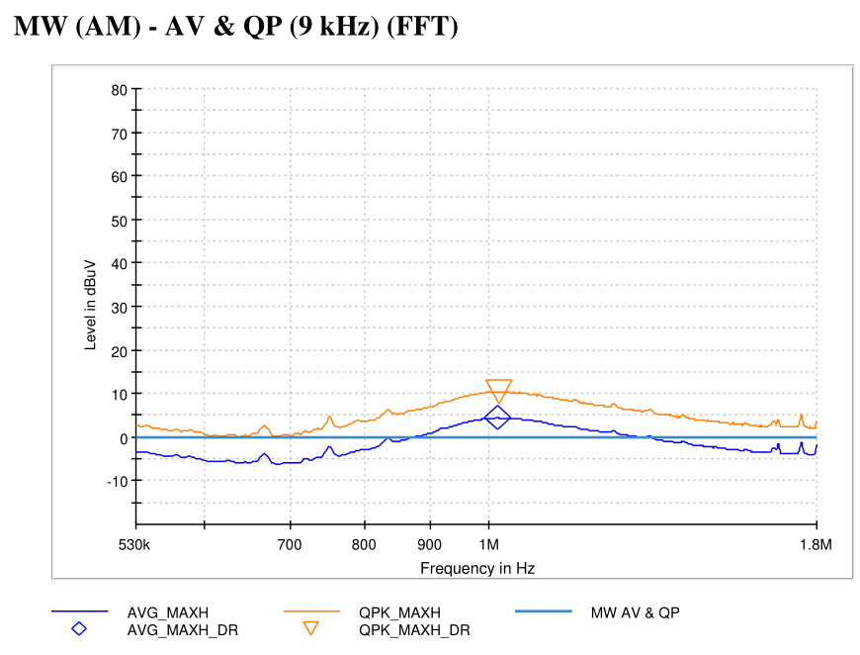
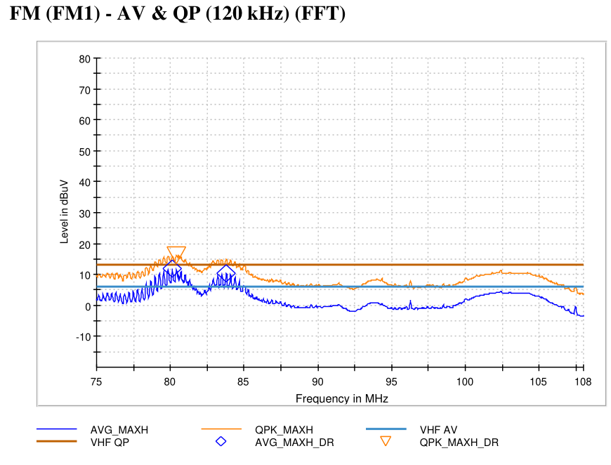
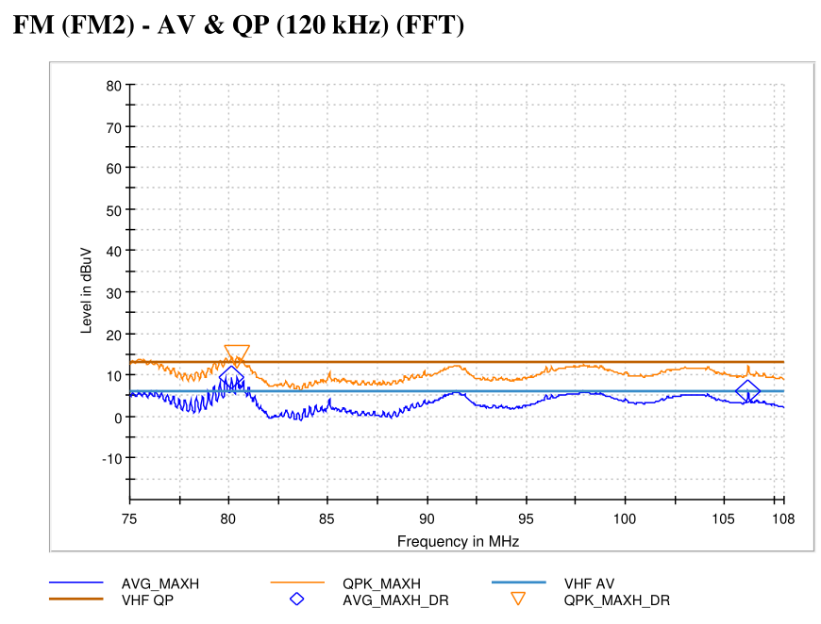




5599 - State 11 | VT-07 On-Board Emissions
State Information

Slide 14
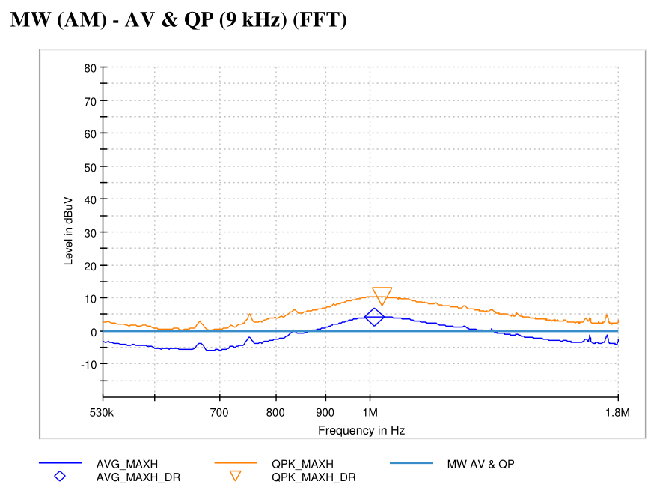
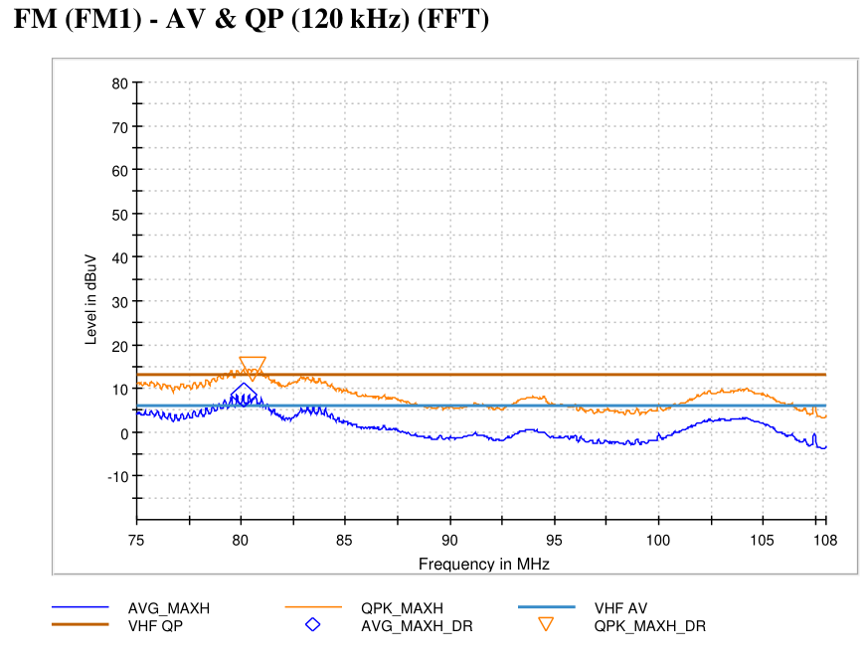

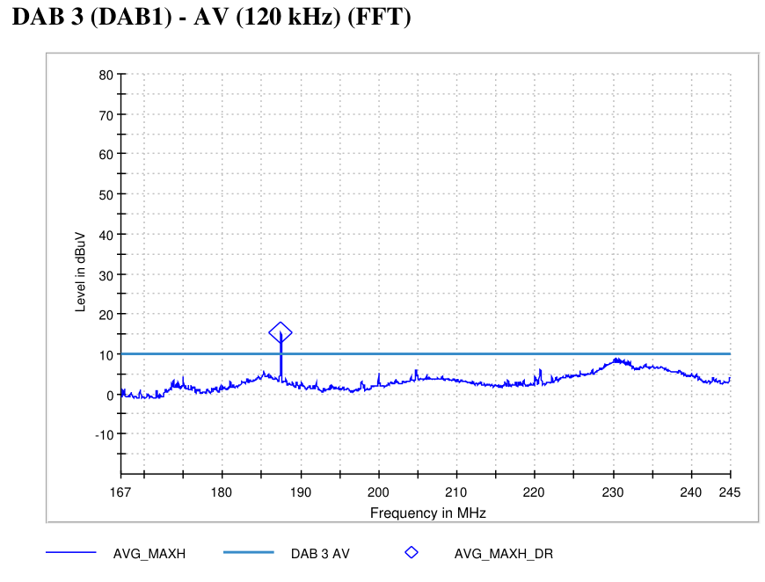

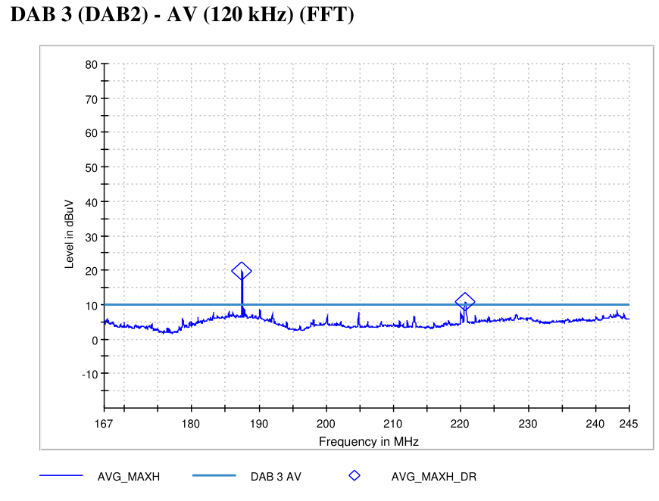

5599 - State 14 | VT-07 On-Board Emissions
State Information

Slide 15
*14*
State Information

Slide 16
*15*
State Information

Slide 17
*16*
State Information

Slide 18
*17*
State Information

Slide 19
*18*
State Information

Slide 20
*19*
State Information

Slide 21
*20*
State Information

Slide 22
*21*
State Information

Slide 23
*22*
State Information

Slide 24
*23*
State Information

Slide 25
*24*
State Information

Slide 26
*25*
State Information

Slide 27
*26*
State Information

Slide 28
*27*
State Information

Slide 29
*28*
State Information

Slide 30
*29*
State Information

Slide 31
*30*
State Information

Slide 32
*31*
State Information

Slide 33
*32*
State Information

Slide 34
*33*
State Information

Slide 35
*34*
State Information

Slide 36
*35*
State Information

Slide 37
*36*
State Information

Slide 38
*37*
State Information

Slide 39
*38*
State Information

Slide 40
*39*
State Information

Slide 41
*40*
State Information

Slide 42
*41*
State Information

Slide 43
*42*
State Information

Slide 44
*43*
State Information

Slide 45
*44*
State Information

Slide 46
*45*
State Information

Slide 47
*46*
State Information

Slide 48
*47*
State Information

Slide 49
*48*
State Information

Slide 50
*49*
State Information

Slide 51
*50*
State Information

Slide 52
*51*
State Information

Slide 53
*52*
State Information

Slide 54
*53*
State Information

Slide 55
*54*
State Information

Slide 56
*55*
State Information

Slide 57
*56*
State Information

Slide 58
*57*
State Information

Slide 59
*58*
State Information

Slide 60
*59*
State Information

Slide 61
*60*
State Information

Slide 62
*61*
State Information

Slide 63
*62*
State Information

Slide 64
*63*
State Information

Slide 65
*64*
State Information

Slide 66
*65*
State Information

Slide 67
*66*
State Information

Slide 68
*67*
State Information

Slide 69
*68*
State Information

Slide 70
*69*
State Information

Slide 71
*70*
State Information

